Slide 1

Project 4
Tongchen He
Joshua Hernandez
Cameron Song
Tien Tran
Ben Wynne

Slide 2
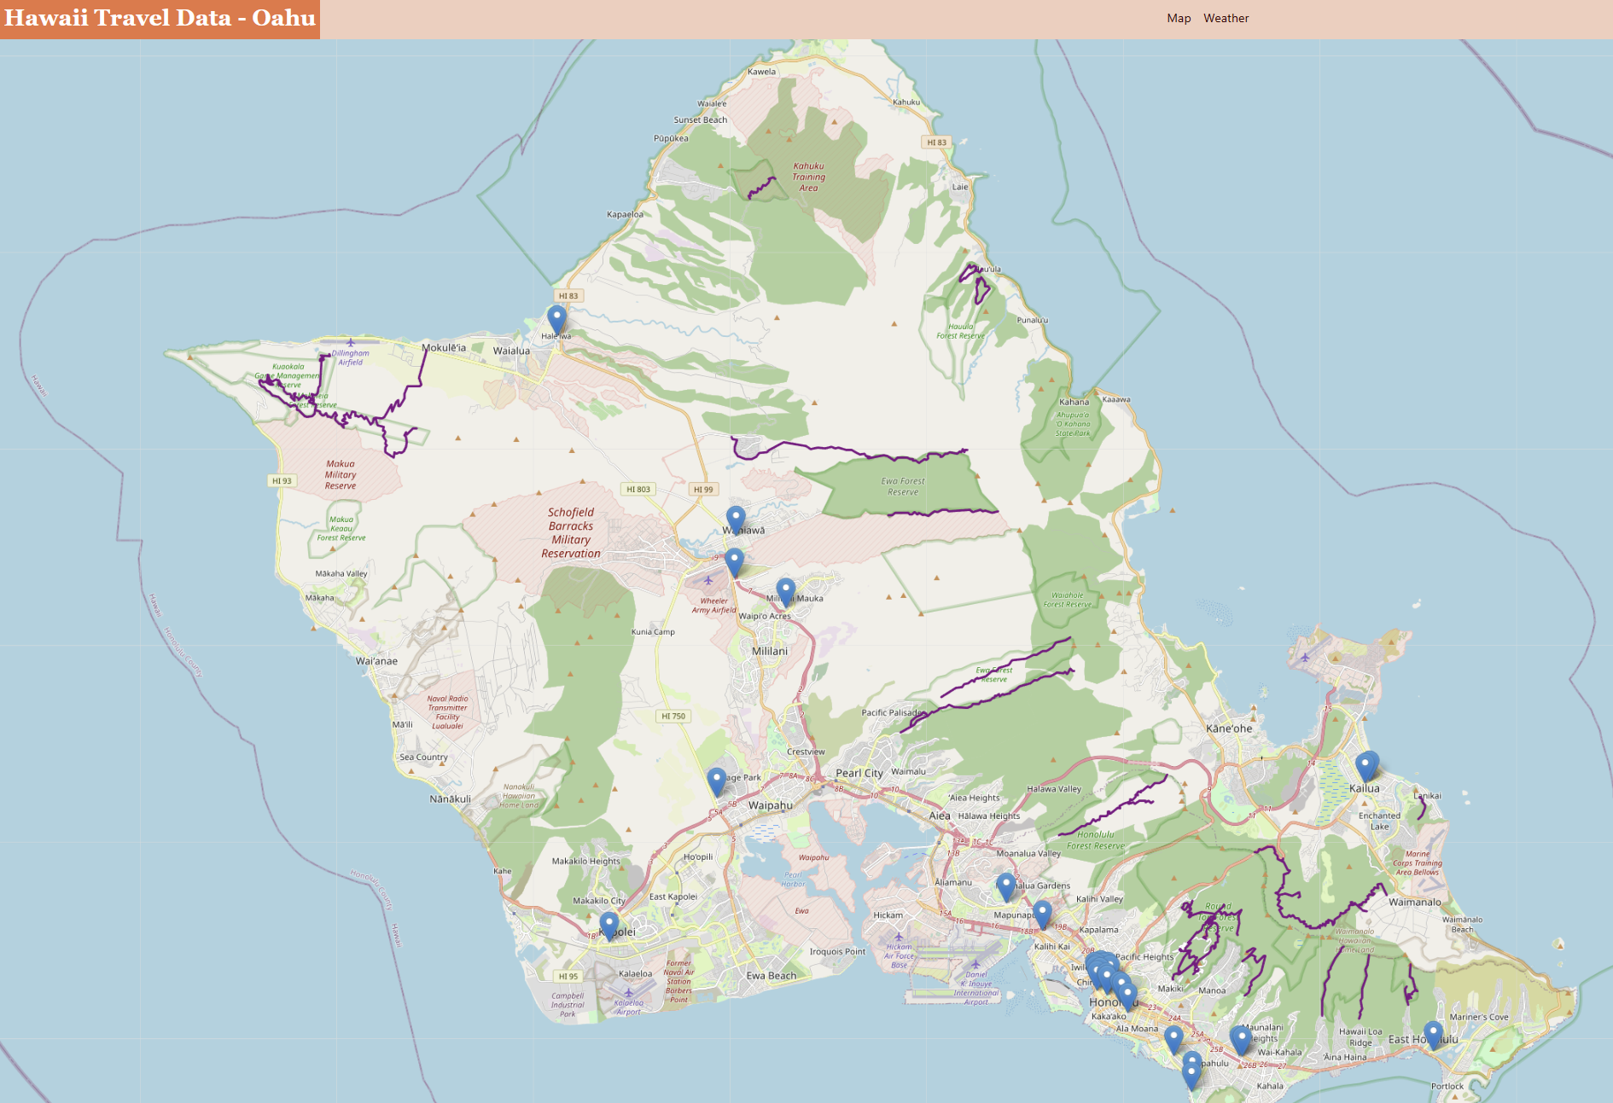
Recap of Project 3

Slide 3

New studies
COVID
-New cases vs deaths
Airfare
-Pricing predictions
Weather
-Tableau visualizations

Slide 4

COVID Presence in Hawaii
New Cases vs Deaths
What does the model’s accuracy mean?

Slide 5
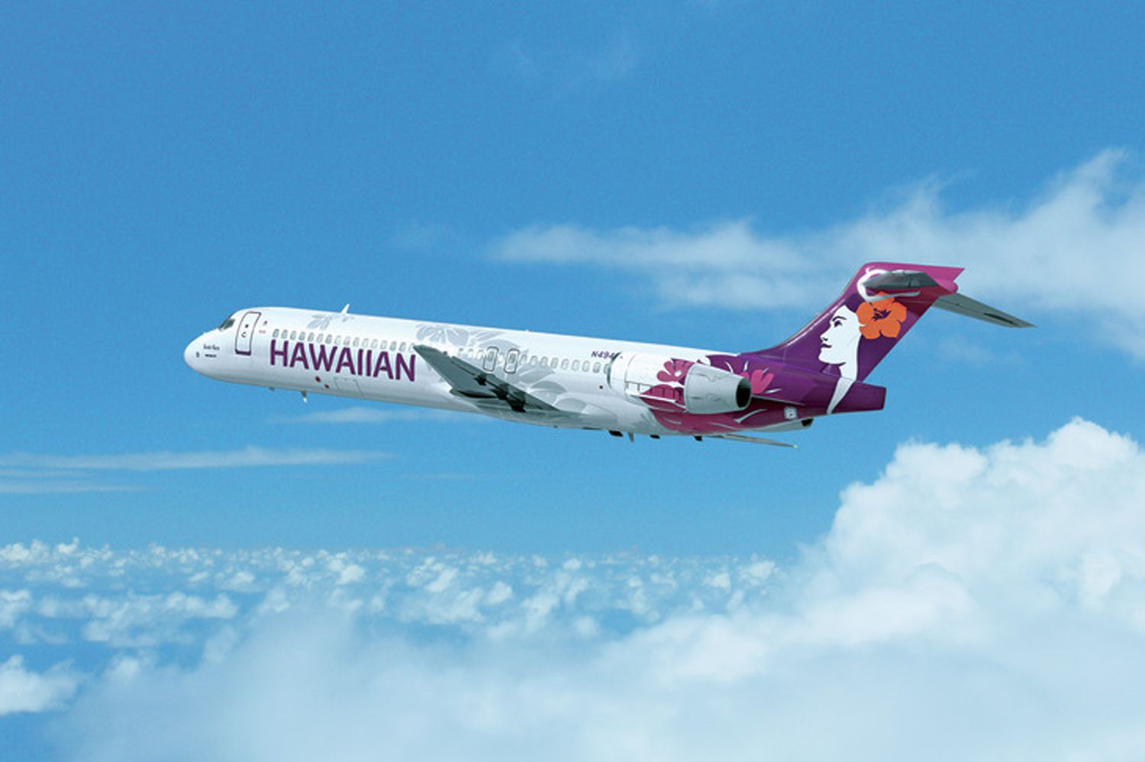
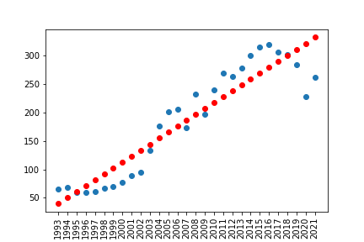

Linear Model of Airfares
Data
Pricing
Prediction:
Average airfare in 2023: $352.24
Average airfare in 2024: $362.64
R² = 0.86

Slide 6
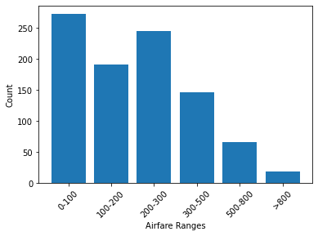
classification Model of Airfares
Bins
Prediction
accuracy = 0.783
airport OGG in 2023 Q1: $300-$500
airport HNL in 2023 Q3: $200-$300

Slide 7

Weather Visualizations
Weather data from SQLITE
Cloudiness
Wind Speed
Humidity
Temperature

